Slide 1
File-System Interface
File Concept
Access Methods
Directory Structure
Protection
Operating System Concepts

Slide 2
File is a named collection of relevant information that is recorded on a secondary storage.
The OS abstracts the physical properties of the storage devices to define a logical storage unit, the file.
It provides the mechanism for storage and access to both programs & data.
The data files may be numeric, alphabetic, binary.
File has certain defined structure ,according to its type. (text file, source file, exe file, etc)
Information about files are kept in the directory structure, and maintained on disks.

Slide 3
File Attributes
Name – only information kept in human-readable form.
Type – needed for systems that support different types.
Location – pointer to file location on device.
Size – current file size.
Protection – controls who can do reading, writing, executing.
Time, date, and user identification – data for protection, security, and usage monitoring.
Information about files are kept in the directory structure, which is maintained on the disk.
Operating System Concepts

Slide 4
File Operations
Create
Write
Read
Reposition within file – file seek
Delete
Truncate
Open(F_{i}) – search the directory structure on disk for entry F_{i}, and move the content of entry to memory.
Close (F_{i}) – move the content of entry F_{i} in memory to directory structure on disk.
Operating System Concepts

Slide 5

File Types – Name, Extension
Operating System Concepts

Slide 6
Sequential Access
Information in the file is processed in order, one record after another.
Based on the tape model of the file.
Time consuming.
Operations:
  Read Next – Reads the next portion of the file and automatically advances a file pointer.
  Write Next – Appends to the end of the file and advances to the end of the newly written material.
  Reset – To the beginning.

Slide 7

Sequential-access File
Operating System Concepts

Slide 8
Direct Access(Relative access)
A file is made up of fixed length logical records that allow programs to read and write in any particular order.
Based on the disk model of the file.
Allows random access to any file block. From 56 to 3 etc.
Eg: Database, airline reservation system(blocks will be flight numbers).
Relative block number is used as n. (an index relative to the beginning of the file).
Operations:
  Read n – n is the block number
  Write n – n is the block number

Slide 9

Example of Index and Relative Files
Operating System Concepts

Slide 10
It is built on top of the direct access
An Index is constructed that contains pointers to the various blocks
To find a record we search the index and then use the pointer to access the file directly and to find the desired record.

Slide 11
Directory Structure
A collection of nodes containing information about all files.
Directory
Files
F 1
F 2
F 3
F 4
F n
Both the directory structure and the files reside on disk.
Backups of these two structures are kept on tapes.
Operating System Concepts

Slide 12

A Typical File-system Organization
Operating System Concepts

Slide 13
Directory Structure
Directory structure organizes and provides information about all files in the system.
Organization includes partitions and device directory.
Organizing includes naming, efficiency, grouping.
Device directory – each partition contains information about all files in the system (volume table of contents).
The directory can be viewed as a symbol table that translate file names into their directory structures.

Slide 14
Information in the directory
Name of the file.
Type of the file.
Address of the file.
Size of the file.
Last accessed date of the file.
Last updated date of the file.
Owner Identification.
Protection information.

Slide 15
Operations Performed on Directory
Search for a file
Create a file
Delete a file
List a directory
Rename a file
Traverse the file system
Operating System Concepts

Slide 16
Organize the Directory (Logically) to Obtain
Efficiency – locating a file quickly.
Naming – convenient to users.
  Two users can have same name for different files.
  The same file can have several different names.
Grouping – logical grouping of files by properties, (e.g., all Java programs, all games, …)
Operating System Concepts

Slide 17

Single-Level Directory
A single directory for all users.
Naming problem
Grouping problem
Operating System Concepts

Slide 18

Two-Level Directory
Separate directory for each user.
Path name
Can have the same file name for different user
Efficient searching
No grouping capability
Operating System Concepts

Slide 19

Tree-Structured Directories
Operating System Concepts

Slide 20
Tree-Structured Directories (Cont.)
Efficient searching
Grouping Capability
Current directory (working directory)
  cd /spell/mail/prog
  type list
Operating System Concepts

Slide 21
Tree-Structured Directories (Cont.)
Absolute or relative path name
Creating a new file is done in current directory.
Delete a file
rm <file-name>
Creating a new subdirectory is done in current directory.
  mkdir <dir-name>
Example: if in current directory /mail
mkdir count
mail
prog
copy
prt
exp
count
Deleting “mail” ⇒ deleting the entire subtree rooted by “mail”.
Operating System Concepts

Slide 22

Acyclic-Graph Directories
Have shared subdirectories and files.
Operating System Concepts

Slide 23
Acyclic-Graph Directories (Cont.)
Two different names (aliasing)
If dict deletes list ⇒ dangling pointer.
It may then point to other files if space is reallocated.
Solutions:
  Backpointers, so we can delete all pointers.
  .
Operating System Concepts

Slide 24
Protection
File owner/creator should be able to control:
  what can be done
  by whom
Types of access
  Read
  Write
  Execute
  Append
  Delete
  List
Operating System Concepts

Slide 25
Access Lists and Groups
Mode of access: read, write, execute
Three classes of users
RWX
a) owner access 7 ⇒ 1 1 1
RWX
b) group access 6 ⇒ 1 1 0
RWX
c) public access 1 ⇒ 0 0 1
Ask manager to create a group (unique name), say G, and add some users to the group.
For a particular file (say game) or subdirectory, define an appropriate access.
owner
group
public
chmod
761
game
Operating System Concepts

Slide 26

Layered File System
Operating System Concepts

Slide 27
File System Layers
Device drivers manage I/O devices at the I/O control layer
  Given commands like “read drive1, cylinder 72, track 2, sector 10, into memory location 1060” outputs low-level hardware specific commands to hardware controller
Basic file system given command like “retrieve block 123” translates to device driver
Also manages memory buffers and caches (allocation, freeing, replacement)
  Buffers hold data in transit
  Caches hold frequently used data
File organization module understands files, logical address, and physical blocks
  Translates logical block # to physical block #
  Manages free space, disk allocation

Slide 28
File System Layers (Cont.)
Logical file system manages metadata information
  Translates file name into file number, file handle, location by maintaining file control blocks (inodes in UNIX)
  Directory management
  Protection

Slide 29

A Typical File Control Block
Operating System Concepts

Slide 30
Allocation Methods
An allocation method refers to how disk blocks are allocated for files:
Contiguous allocation
Linked allocation
Indexed allocation
Operating System Concepts

Slide 31
Contiguous Allocation
Each file occupies a set of contiguous blocks on the disk.
Simple – only starting location (block #) and length (number of blocks) are required.
Random access.
Wasteful of space (dynamic storage-allocation problem).
Files cannot grow.
Operating System Concepts

Slide 32

Contiguous Allocation of Disk Space
Operating System Concepts

Slide 33
Extent-Based Systems
Many newer file use a modified contiguous allocation scheme.
Extent-based file systems allocate disk blocks in extents.
An extent is a contiguous block of disks. Extents are allocated for file allocation. A file consists of one or more extents.
Operating System Concepts

Slide 34
Allocation Methods - Linked
Linked allocation – each file a linked list of blocks
  File ends at nil pointer
  No external fragmentation
  Each block contains pointer to next block
  No compaction, external fragmentation
  Free space management system called when new block needed
  Improve efficiency by clustering blocks into groups but increases internal fragmentation
  Reliability can be a problem
  Locating a block can take many I/Os and disk seeks

Slide 35

Linked Allocation
Operating System Concepts

Slide 36
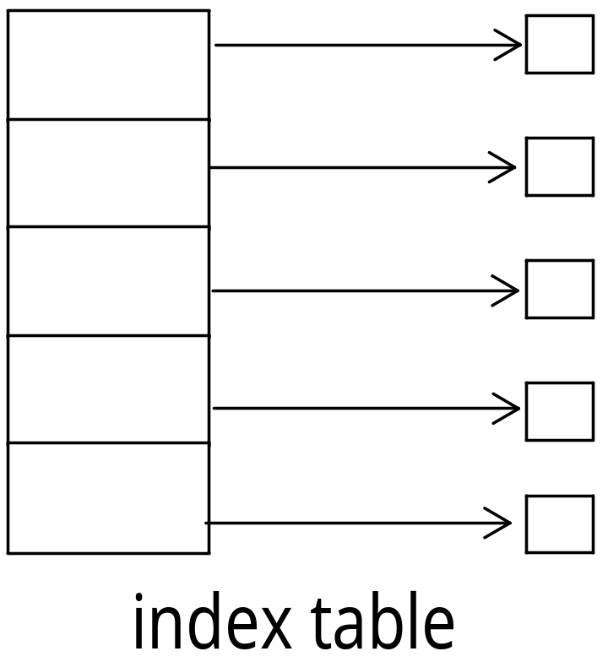
Allocation Methods - Indexed
Indexed allocation
  Each file has its own index block(s) of pointers to its data blocks
Logical view

Slide 37

Example of Indexed Allocation
Operating System Concepts

Slide 38
Indexed Allocation (Cont.)
Need index table
Random access
Dynamic access without external fragmentation, but have overhead of index block
Mapping from logical to physical in a file of maximum size of 256K bytes and block size of 512 bytes. We need only 1 block for index table

Slide 39
Performance
Best method depends on file access type
  Contiguous great for sequential and random
Linked good for sequential, not random
Indexed more complex
  Single block access could require 2 index block reads then data block read
  Clustering can help improve throughput, reduce CPU overhead

